Slide 1
Chapter 4
Grammars and Parsing
1

Slide 2
Grammar
Grammars, or more precisely, context-free grammars, are the formalism for describing the structure of program in programming languages.
A grammar consists of a set of production rules and a start symbol (left symbol of first rule).
A production rule consists of two parts: a left-hand side and a right-hand side.
ex: expression → expression ‘+’ term
2
2
left-hand side
right-hand side
2

Slide 3
Grammar (Cont.)
3
3
3
The left-hand side is the name of the syntactic construct.
The right-hand side shows a possible form of the syntactic construct.
There are two possible forms (rules) derived by the name “expression”:
expression → expression ‘+’ term (rule 1)
expression → expression ‘-’ term (rule 2)

Slide 4
Grammar (Cont.)
The right-hand side of a production rule can contain two kinds of symbols:
terminal and non-terminal.
A terminal symbol (or terminal) is an end point of the production process, also called token. Use lower-case letters such as a, b.
A non-terminal symbol (or non-terminal) must occur as the left-hand side of one or more production rules.
Use upper-case letters such as A, B, S.
Non-terminal and terminal together are called grammar symbols.
4
4
4

Slide 5
production process
5
5
5
A string of terminals can be produced from a grammar by applying productions to a sentential form. (see example next)
The steps in the production process leading from the start symbol to a string of terminal are called:
The derivation of that string of terminals.

Slide 6
An example of production process
Grammar :
expression → ‘(‘ expression operator expression ‘)’
expression → ‘1’
operator → ‘+’
operator → ‘*’
6
6
6

Slide 7
An example of production process (Cont.)
Derivation of the string (1*(1+1))
expression
‘(‘ expression operator expression ‘)’
‘(‘ ‘1’ operator expression ‘)’
‘(‘ ‘1’ ‘*’ expression ‘)’
‘(‘ ‘1’ ‘*’ ‘(‘ expression operator expression ‘)’ ‘)’
‘(‘ ‘1’ ‘*’ ‘(‘ ‘1’ operator expression ‘)’ ‘)’
‘(‘ ‘1’ ‘*’ ‘(‘ ‘1’ ‘+’ expression ‘)’ ‘)’
‘(‘ ‘1’ ‘*’ ‘(‘ ‘1’ ‘+’ ‘1’ ‘)’ ‘)’
Each of the above is a sentential form
It forms a leftmost derivation, in which it is always the leftmost non-terminal in the sentential form that is rewritten.
7
7
7

Slide 8
Think
Why we need to discover some specific rules for derivation? Let’s look at the original problem, I have too many possible ways to choose production rules and even you choose one, you don’t know if this step can lead to derive the token streams you need.
It is hard if we try to build such a SMART parser.
Machine are stupid, we better clarify the problem and so that a parser can work economically.
Sometimes this means we need to give up some freedom of the grammar we wrote.

Slide 9
The definition of a grammar
Context-free grammar (CFG) is defined by:
(1) A finite terminal vocabulary Vt; this is the token set produced by the scanner.
(2) A finite set of different, intermediate symbols, called the non-terminal vocabulary Vn.
(3) A start symbol S Vn that starts all derivations. A start symbol is sometimes called a goal symbol.
(4) P, a finite set of productions (sometimes called rewriting rules) of the form A → X1…Xm, where
A Vn, Xi Vn ∪ Vt, 1<=i<=m, m>=0
9
9
9

Slide 10
The definition of a grammar (Cont.)
Given two sets of symbols V1, V2
A production rule is
(N, α) such that N V1, α V2*
Context free grammar G=(Vn, Vt, S, P)
Vn ∩ Vt = Φ
S Vn
P { (N, α) | N Vn, α (Vn ∪ Vt)*}
10
10
10

Slide 11
BNF form of grammars
Backus-Naur Form (BNF) is a formal grammar for expressing context-free grammars.
The single grammar rule format:
Non-terminal → zero or more grammar symbols
It is usual to combine all rules with the same left-hand side into one rule, such as:
N → α
N → β
N → γ
Greek letters α,β, or γ means a string of symbols.
are combined into one rule:
N → α | β | γ
α, β and γ are called the alternatives of N.
11
11
11

Slide 12
Extended BNF form of grammars
BNF is very suitable for expressing nesting and recursion, but less convenient for repetition and optionality.
Three additional postfix operators +,?, and *, are thus introduced:
R+ indicates the occurrence of one or more Rs, to express repetition.
R? indicates the occurrence of zero or one Rs, to express optionality.
R* indicates the occurrence of zero or more Rs, to express repetition.
The grammar that allows the above is called Extended BNF (EBNF).
12
12
12

Slide 13
Extended forms of grammars (Cont.)
An example is the grammar rule:
parameter_list →
(’IN’ | ‘OUT’)? identifier (‘,’ identifier)*
which produces program fragments like:
a, b
IN year, month, day
OUT left, right
13
13
13

Slide 14
Extended forms of grammars (Cont.)
14
14
14
Rewrite EBNF grammar to CFG
Given the EBNF grammar:
expression → term (+ term)*
Rewrite it to:
expression → term term_tmp
term_tmp → + term term_tmp
| λ

Slide 15
Properties of grammars
15
15
15
A non-terminal N is left-recursive if, starting with a sentential form N, we can produce another sentential form starting with N.
ex: expression → expression ‘+’ factor | factor
right-recursion also exists, but is less important.
ex: expression → term ‘+’ expression

Slide 16
Properties of grammars (Cont.)
A non-terminal N is nullable, if starting with a sentential form N, we can produce an empty sentential form.
example:
expression → λ
A non-terminal N is useless, if it can never produce a string of terminal symbols.
example:
expression → + expression
| - expression
16
16
16

Slide 17
Ambiguity
17
17
17
A grammar can have more than one parse tree generating a given string of terminals. Such a grammar is said to be ambiguous.
Given the grammar:
string → string + string
| string – string
| 0 | 1 | 2 | 3 | 4 | 5 | 6 | 7 | 8 | 9
Two parse trees for 9-5+2 can be constructed below. Thus, the grammar is ambiguous.

Slide 18
Ambiguity
string string
string + string string - string
string - string 2 9 string + string
9 5 5 2
18
18
18

Slide 19
Associativity of operators
19
19
19
Left-associativity:
9+5+2 is equivalent to 9+5+2
Given the grammar:
list → list + digit
| list – digit
| digit
digit → 0 | 1 | 2 | 3 | 4 | 5 | 6 | 7 | 8 | 9

Slide 20
Associativity of operators (Cont.)
Parse tree for 9+5+2
using a left-associative grammar
list
list + digit
list + digit 2
digit 5
9
20
20
20

Slide 21
Associativity of operators (Cont.)
21
21
21
Right-associativity: expression a=b=c is treated in the same way as the expression a=b=c
Given the grammar:
right → letter = right
| letter
letter → a | b | … | z

Slide 22
Associativity of operators (Cont.)
22
22
22
Parse tree for a=b=c using a right-associative grammar.
right
letter = right
a letter = right
b letter
c

Slide 23
From tokens to parse tree
23
The process of finding the structure (parse tree) in the flat stream of tokens is called parsing,
and the module that performs this task is called parser.

Slide 24
Parsing methods
The way to construct the parse tree:
Leaf nodes are labeled with terminals and inner nodes are labeled with non-terminals.
The top node is labeled with the start symbol.
The children of an inner node labeled N correspond to the members of an alternative of N, in the same order as they occur in that alternative.
The terminals labeling the leaf nodes correspond to the sequence of tokens, in the same order as they occur in the input.
24

Slide 25
Parsing methods
There are two well-known ways to parse:
1) top-down
Left-scan, Leftmost derivation (LL).
2) bottom-up
Left-scan, Rightmost derivation in reverse (LR).
LL constructs the parse tree in pre-order;
LR in post-order.

Slide 26
Pre-order vs. post-order traversal
When traversing a node N in pre-order, the process first visits the node N and then traverses N’s subtrees in left-to-right order.
When traversing a node N in post-order, the process first traverses N’s subtrees in left-to-right order and then visits the node N.

Slide 27
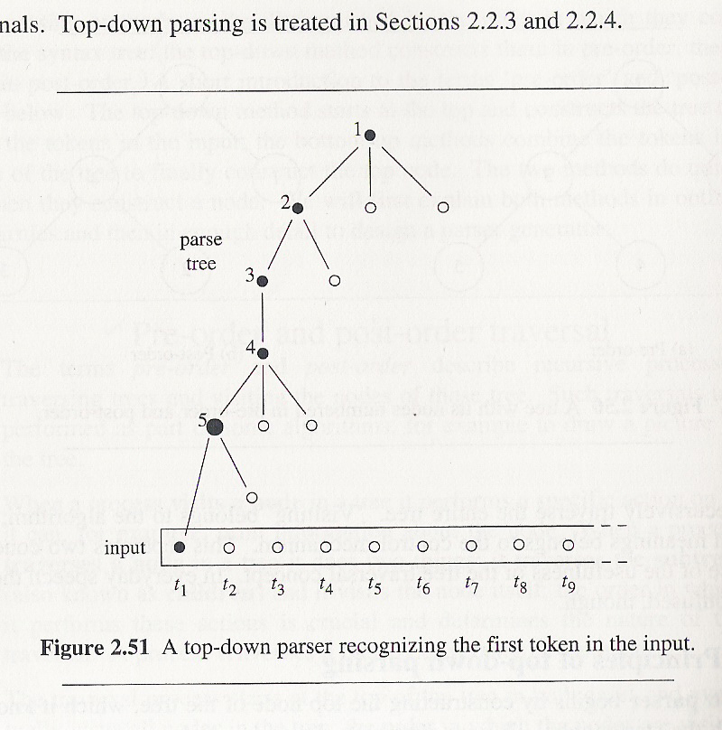
Principle of top-down parsing
A top-down parser begins by constructing the top node of the parse tree, which is the start symbol.
27

Slide 28
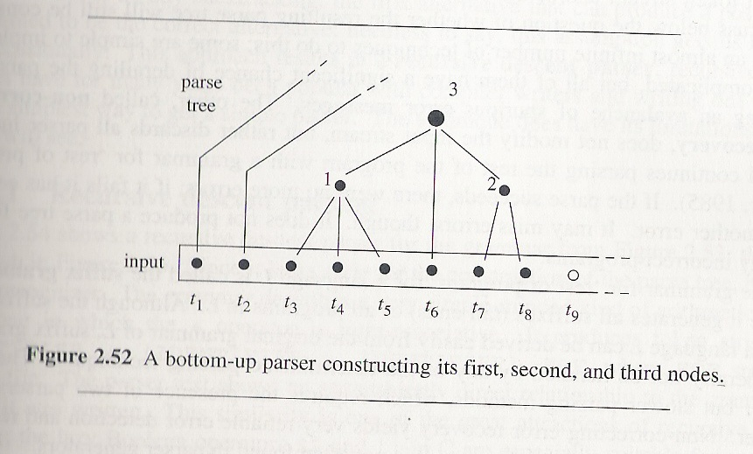
Principles of bottom-up parsing
28
The bottom-up parsing method constructs the nodes in the parse tree in post-order.

Slide 29
First and Follow
29
The construction of both top-down and bottom-up parsers is aided by two functions: FIRST and FOLLOW.
Define FIRST(α),where α is any string of grammar symbols,to be:
the set of terminals
that begin strings derived from α.

Slide 30
Why we want to compute First and FOLLOW set?
As stated in previous section, when you have two production rules to choose from, a deterministic choices allow efficient/cheap parser to be built.
A-> aB

Slide 31
First and Follow (Cont.)
Given the grammar:
input → expression
expression → term rest_expression
term → ID | parenthesized_expression
parenthesized_expression → ‘(‘ expression ‘)’
rest_expression → ‘+’ expression | λ
FIRST (input) = FIRST(expression) =FIRST (term)
={ ID, ‘(‘ }
FIRST (parenthesized_expression) = { ‘( ‘}
FIRST (rest_expression) = { ‘+’ λ}
31

Slide 32
First and Follow (Cont.)
Given the grammar (E for expression, T for term, F for factor) :
E → TE’
E’ → +TE’ | λ
T → FT’
T’ → *FT’ | λ
F → (E) | id
Find the first set of each symbol.
32

Slide 33
First and Follow (Cont.)
33
Answer:
FIRST(F) = FIRST(T) = FIRST(E) = {(, id }
FIRST(E’) = {+, λ}
FIRST(T’) = {*, λ}

Slide 34
First and Follow (Cont.)
To compute FIRST(X) for grammar symbol X, apply the following rules until no more terminals or λ can be added to it.
1. If X is a terminal , then FIRST(X)={X}
2. If X is a non-terminal and X → Y₁Y₂…Y_{k} is a production for some k>=1, then place “a” in FIRST(X) if for some i, “a” is in FIRST(Y_{i}), and λ is in all of FIRST(Y₁),…,FIRST(Y_{i-1}). If λ is in FIRST(Y_{j}) for all j=1,2,…,k, then add λ to FIRST(X).
3. If X → λ is a production, then add λ to FIRST(X).
34

Slide 35
First and Follow (Cont.)
To compute FOLLOW(B) for non-terminal B:
1. Place ＄ in FOLLOW(S), where S is the start symbol, and ＄ is the input right end-marker.
2. if there is a production A → α B β, then everything in FIRST(β) except λ is in FOLLOW(B).
3. (a) if there is a production A → α B,
(b) or A → α B β, where FIRST(β) contains λ,
then everything in FOLLOW(A) is in FOLLOW(B).
35

Slide 36
First and Follow (Cont.)
input → expression
expression → term rest_expression
term → ID | parenthesized_expression
parenthesized_expression → ‘(‘ expression ‘)’
rest_expression → ‘+’ expression | λ
FOLLOW (input) = { $ } rule 1
FOLLOW (expression) = { $ ‘)’} rule 3(a) got $; rule 2 got )
FOLLOW (term) = FOLLOW (parenthesized_expression) rule3(a)
= {‘+’ $ ‘)’ } rule 2 got +; rule 3(b) got $ )
FOLLOW (rest_expression) = { $ ‘)’} rule 3(a)
36

Slide 37
First and Follow (Cont.)
For example, given the grammar :
E → TE’
E’ → +TE’ | λ
T → FT’
T’ → *FT’ | λ
F → (E) | id
Find the follow set of each symbol.
37

Slide 38
First and Follow (Cont.)
38
Answers:
FOLLOW(E) = FOLLOW(E’) = { ）, ＄}
FOLLOW(T) = FOLLOW(T’) = { +, ）, ＄}
FOLLOW(F) = {＊, + , ）, ＄}

Slide 39
Homework
8. A grammar for infix expressions follows:
1 Start → E $
2 E → T plus E
3 | T
4 T → T times F
5 | F
6 F → ( E )
7 | num

Slide 40
Homework (Cont.)
(a) Show the leftmost derivation of the following string.
num plus num times num plus num $
(b) Show the rightmost derivation of the following string.
num times num plus num times num $
(c) Describe how this grammar structures expressions, in terms of the precedence and left- or right- associativity of operators.

Slide 41
Homework Solution 8
Leftmost derivation
- Start
- E $
- T plus E $
- F plus E $
- num plus E $
- num plus T plus E $
- num plus T times F plus E $
- num plus F times F plus E $
- num plus num times F plus E $
- num plus num times num plus E $
- num plus num times num plus T $
- num plus num times num plus F $
- num plus num times num plus num $

Slide 42
Homework Solution 8 (Cont.)
(b) Rightmost derivation
-Start
-E $
-T plus E $
-T plus T $
-T plus T times F $
-T plus T times num $
-T plus F times num $
-T plus num times num $
-T times F plus num times num $
-T times num plus num times num $
-F times num plus num times num $
-num times num plus num times num $

Slide 43
Homework Solution 8 (Cont.)
(C) This grammar ensures that “times” precedes “plus”.
for 1+2+3 first 2+3 then 1+5 so operand 2 is associated with its right operator. that is, right-associativity for “plus” operator.
what if 1-2+3? This will get 1-5 or -4 wrong!
for 3*4*5 first 3*4 then 12*5 so operand 4 is associated with its left operator
that is, left-associativity for “times”

Slide 44
Homework (Cont.)
11 Compute First and Follow sets for the non-terminals of the following grammar
1 S → a S e
2 | B
3 B → b B e
4 | C
5 C → c C e
6 | d

Slide 45
Homework Solution 11
First (S)={a, b, c, d}
First (B)={b, c, d}
First (C)={c, d}
Follow (S) = Follow (B) = Follow (C) = {e}

